Slide 1


Data Governance, Compliance and Ethics
Lecture 0: Introduction to Course
vikas.sahni@ncirl.ie

Slide 2
Overview
Introduction and Module Team
Staying Connected
Course contents
  Learning objectives
  Course Outline (in next slide deck)
Arrangements for Course delivery
Course Timeline
Arrangements for labs tutorials
  Timeline
  Delivery methods
Course Assessments
Course Reading and Resources

Slide 3
Module Team
Content Creator: Jaswinder Singh
Lecturer: Vikas Sahni (vikas.sahni@ncirl.ie)

Slide 4
Staying connected
Watch for course announcements through Moodle.
“Ask a question”: Use this to ask general course related questions so that others can participate and see answers
For questions specifically related to your own participation on course:
Use the Tutorial time
Request for deferrals etc. to NCI360 (https://nci360.ncirl.ie/)
Note: Communication outside class should be through email. Please do not use MS Teams for messaging outside of class.

Slide 5
Learning Outcomes (MSCCLOUD)
# | Learning Outcome Description
LO1 | Critically interpret the corporate Governance, Compliance and regulatory frameworks associated with the capture, processing, and stewardship of Data.
LO2 | Critically interpret the roles and responsibilities pertaining to data security, privacy, risk management, and data protection. Data protection and GDPR as key constraints in the business environment to be reflected in the internal environment of the organisation.
LO3 | Evaluate ethical constructs and their dynamic evolution within an ICT data environment and appraise the interplay of fairness, accountability, and transparency in algorithmic decision making systems.

Slide 6
Arrangements for Course Delivery
All course materials (lecture notes, activities, resources via Moodle page).
Main Moodle Page: MSCCLOUD
Self Enrolment Link: https://moodle2025.ncirl.ie/course/view.php?id=1382
Lecture and Tutorials (Week 2 onwards): Theatre 2, Mayor Square Building
10:00 – 12:00 pm lecture
09:00 – 10:00 Group A tutorial, 12:00 – 13:00 Group B tutorial
Normally try to take a 10/15 minute comfort break around 11:00

Slide 7
Course Assessment
Extent to which students meet learning objectives assessed as follows:
Assessment Type: Continuous Assessment
This assessment element will assess learners’ insights and evaluation of ethical issues that are related to their own research work.
% of total: 40
Assessment Due: 9th July 2026
Learning Outcomes addressed: 1,2,3

Slide 8
Course Assessment
Assessment Type: Paper-based invigilated exam
This will assess learners’ knowledge, in-depth understanding and ability to appraise and address issues relating to data governance, ethics, privacy, data protection, fairness, accountability, and transparency of algorithmic systems .
% of total: 60
Assessment Due: Exams Period (4th August – 22nd August, 2026 )
Learning Outcome(s) addressed: 1,2,3

Slide 9
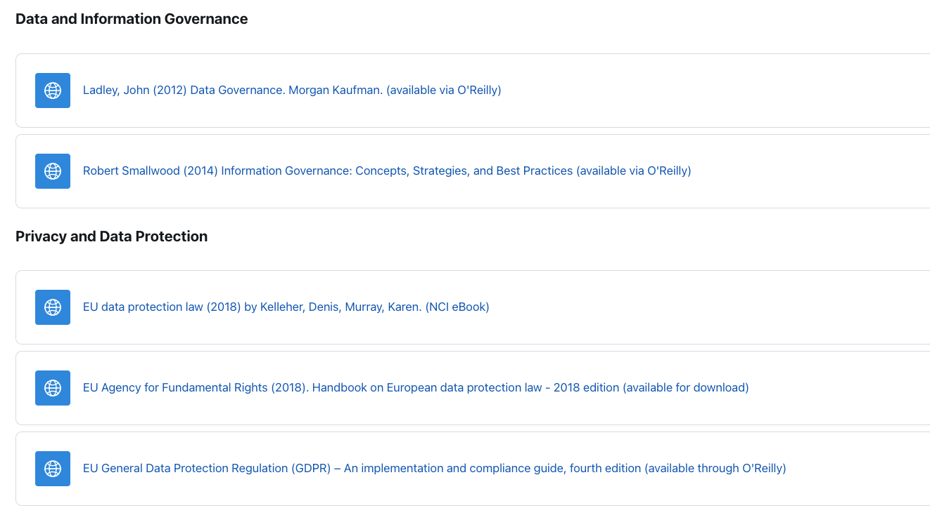
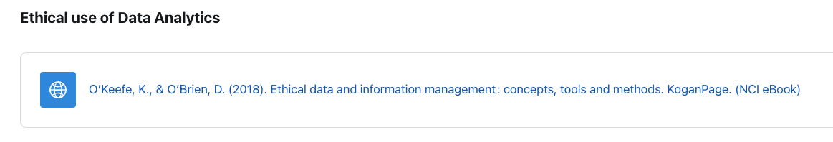
Course readings and resources
Online access to several readings will be made available through the Moodle page
Specific chapter/papers/articles will be indicated in the section for the weekly lecture
Other readings will be added as appropriate

Slide 10

Questions?

